Slide 1
CARS prices Dashboard analysis
A Data-Driven Insight into Car Sales in the U.S.
Prepared By: Mohamed Dahi
Date: 12/24/2024

Slide 2
Objective
Analyze car sales data to uncover trends and customer preferences, providing actionable insights for stakeholders.
Data source
Kaggle
Sales performance trends (yearly, monthly, and daily).
Regional insights (top-performing states).
Manufacturer and model analysis.
Customer preferences (colors and body types).
Scope

Slide 3
Tools and Techniques
Tools Used
Excel Power Query for data cleaning and transformation.
Power BI for dashboard development and visualization.
Techniques
Data integration and transformation.
Exploratory data analysis (EDA).
Interactive dashboard design.

Slide 4
Data Preparation
Cleaned and transformed data using Power Query.
Created calculated fields and measures for analysis.
Process
Challenges Solved
Missing values and data inconsistencies.
Streamlined processes for repeatable analysis.

Slide 5
Dashboard Features
Key Components
Sales Trends: Annual, monthly, and daily patterns.
Regional Performance: Analysis of top-selling states.
Customer Preferences: Popular car models, colors, and body types.
Manufacturer Insights: Sales performance by top brands.
Interactive Features
Filters and slicers for dynamic exploration.
Drill-through pages for detailed analysis.

Slide 6
Key Insights
Top Manufacturers: Ford and Chevrolet lead sales, accounting for over 50% of the total.
Regional Leaders: Florida and California are the highest-performing states.
Customer Preferences:
Most popular colors: Black and white.
Preferred body types: Sedans and SUVs.
4. Sales Trends:
Peak sales months: March and December.
Over 97% of sales are from automatic cars.

Slide 7
Visual Highlights

Slide 8
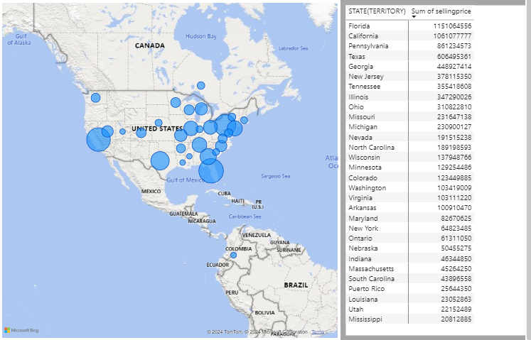
Map Sales

Slide 9
Recommendations
Actionable Insights
Focus on high-performing states (Florida, California) for marketing campaigns.
Prioritize inventory of popular models and colors.
Schedule targeted promotions during high-sales months (March, December).
Future Enhancements
Integrate demographic data for richer insights.
Implement real-time data updates for live monitoring.

